Slide 1
Tutorial on Quanty at ESRF
Intro
Maurits W. Haverkort
Institute for theoretical physics – Heidelberg University
M.W.Haverkort@thphys.uni-heidelberg.de

Slide 2
Quanty
Quanty is a script language which allows the user to program quantum mechanical problems in second quantization and when possible solve these.
Notes:
I know that the 1s to 2p excitation of H is not in the x-ray range ( ¾ Rydberg, 10.2 eV) but all our theories are conveniently rather independent from the actual energy scale. (Linear response does not depend on the value of omega) For the purist replace H by Fe25+ (also a single electron around a nucleus, but as Z=26 in this case the excitation energy is 26^2 * ¾ = 507 Rydberg or 6898 eV)

Slide 3
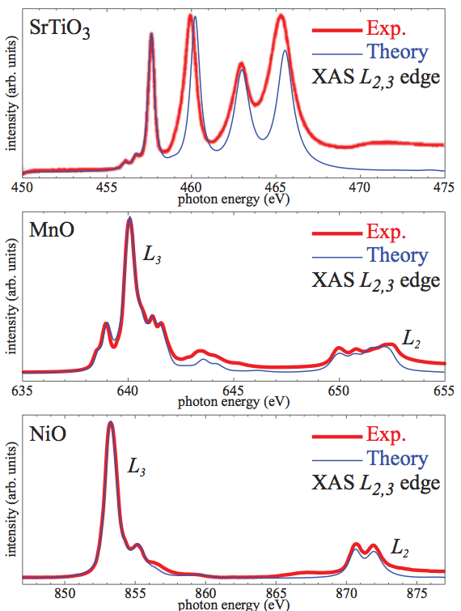
Quanty - XAS
L₂₃ edges transition metal compounds (possibly ab initio)
PRB 85, 165113 (2012)
Notes:
I know that the 1s to 2p excitation of H is not in the x-ray range ( ¾ Rydberg, 10.2 eV) but all our theories are conveniently rather independent from the actual energy scale. (Linear response does not depend on the value of omega) For the purist replace H by Fe25+ (also a single electron around a nucleus, but as Z=26 in this case the excitation energy is 26^2 * ¾ = 507 Rydberg or 6898 eV)

Slide 4
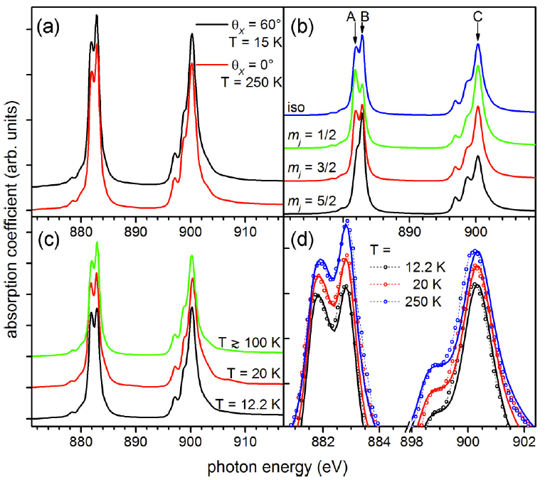
Quanty - XAS
M₄₅ edges rare-earth (including Stevens Operator formalism)
PRB 93, 165107 (2016)
Notes:
I know that the 1s to 2p excitation of H is not in the x-ray range ( ¾ Rydberg, 10.2 eV) but all our theories are conveniently rather independent from the actual energy scale. (Linear response does not depend on the value of omega) For the purist replace H by Fe25+ (also a single electron around a nucleus, but as Z=26 in this case the excitation energy is 26^2 * ¾ = 507 Rydberg or 6898 eV)

Slide 5
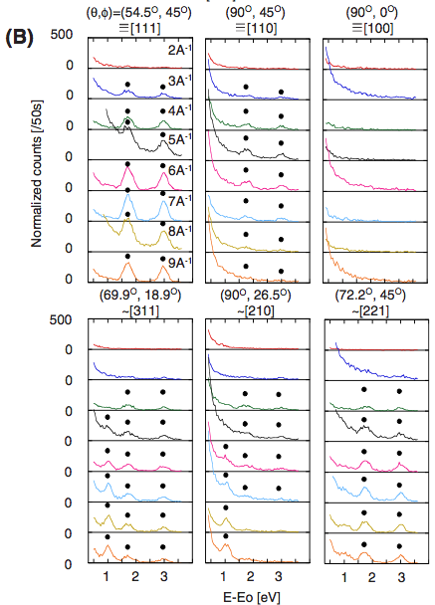
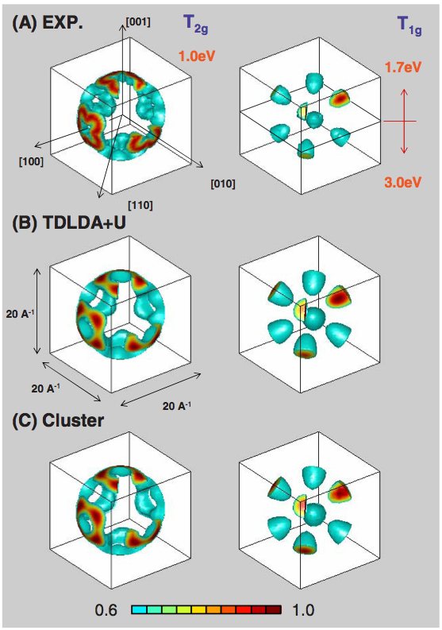
Quanty – non-resonant IXS
Angular dependence of d-d excitations in NiO
EPL 96, 37007 (2011)
Notes:
I know that the 1s to 2p excitation of H is not in the x-ray range ( ¾ Rydberg, 10.2 eV) but all our theories are conveniently rather independent from the actual energy scale. (Linear response does not depend on the value of omega) For the purist replace H by Fe25+ (also a single electron around a nucleus, but as Z=26 in this case the excitation energy is 26^2 * ¾ = 507 Rydberg or 6898 eV)

Slide 6
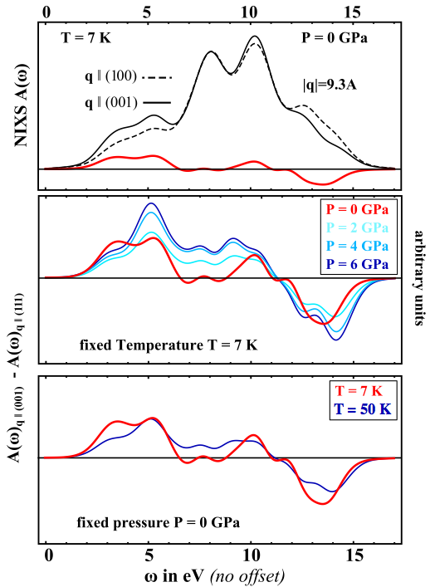
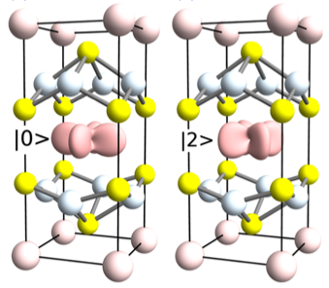
Quanty – non-resonant IXS
Orbital orientation and transition in CeCu₂Si₂
PRL 112, 106407 (2014) – PRL 109, 046401 (2012) – PRB 91, 201108 (2015)
Notes:
I know that the 1s to 2p excitation of H is not in the x-ray range ( ¾ Rydberg, 10.2 eV) but all our theories are conveniently rather independent from the actual energy scale. (Linear response does not depend on the value of omega) For the purist replace H by Fe25+ (also a single electron around a nucleus, but as Z=26 in this case the excitation energy is 26^2 * ¾ = 507 Rydberg or 6898 eV)

Slide 7
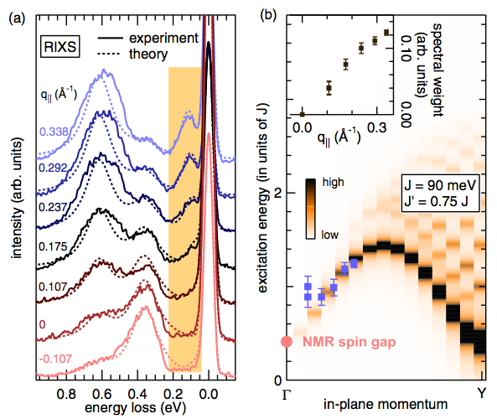
Quanty – RIXS
Orbital and dispersing magnetic transitions in TiOCl
PRL 107, 107402 (2011).
Notes:
I know that the 1s to 2p excitation of H is not in the x-ray range ( ¾ Rydberg, 10.2 eV) but all our theories are conveniently rather independent from the actual energy scale. (Linear response does not depend on the value of omega) For the purist replace H by Fe25+ (also a single electron around a nucleus, but as Z=26 in this case the excitation energy is 26^2 * ¾ = 507 Rydberg or 6898 eV)

Slide 8
Quanty – Optics
Fe impurities in glass
PhD. Thesis Vincent Vercamer

Slide 9
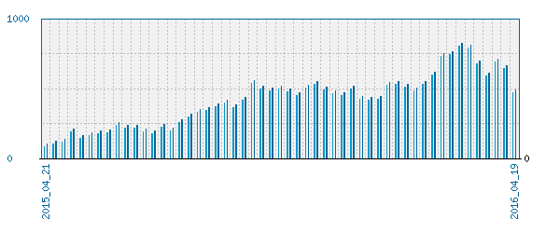
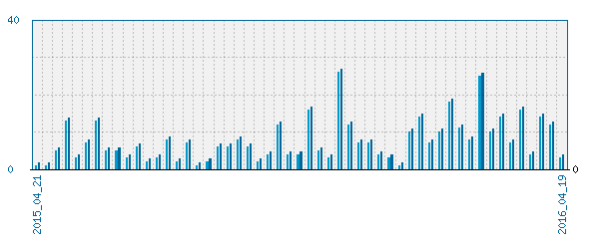
Quanty – growing user community (online since one year)
1000
Website visits per unique user per week
0
40
Code downloads per week
~300 registered users
~500 downloads
0
2015/04/21
2016/04/19
Notes:
I know that the 1s to 2p excitation of H is not in the x-ray range ( ¾ Rydberg, 10.2 eV) but all our theories are conveniently rather independent from the actual energy scale. (Linear response does not depend on the value of omega) For the purist replace H by Fe25+ (also a single electron around a nucleus, but as Z=26 in this case the excitation energy is 26^2 * ¾ = 507 Rydberg or 6898 eV)

Slide 10
Quanty – also
DMFT
Post LDA or Hartree-fock method (ab-initio)
Calculate the ligand-field theory parameters
Resonances – (interaction between localized and itinerant states)
Dynamics (arbitrary order response functions in frequency and time domain)
K-edge (dipole + quadrupole + interference)
Focus today on transition metal L₂₃ and rare-earth M₄₅ edges (excitons) different forms of spectroscopy using parameter based crystal and ligand field theory
Notes:
I know that the 1s to 2p excitation of H is not in the x-ray range ( ¾ Rydberg, 10.2 eV) but all our theories are conveniently rather independent from the actual energy scale. (Linear response does not depend on the value of omega) For the purist replace H by Fe25+ (also a single electron around a nucleus, but as Z=26 in this case the excitation energy is 26^2 * ¾ = 507 Rydberg or 6898 eV)

Slide 11
Intro spectroscopy
Notes:
I know that the 1s to 2p excitation of H is not in the x-ray range ( ¾ Rydberg, 10.2 eV) but all our theories are conveniently rather independent from the actual energy scale. (Linear response does not depend on the value of omega) For the purist replace H by Fe25+ (also a single electron around a nucleus, but as Z=26 in this case the excitation energy is 26^2 * ¾ = 507 Rydberg or 6898 eV)

